Slide 1
angular

Slide 2
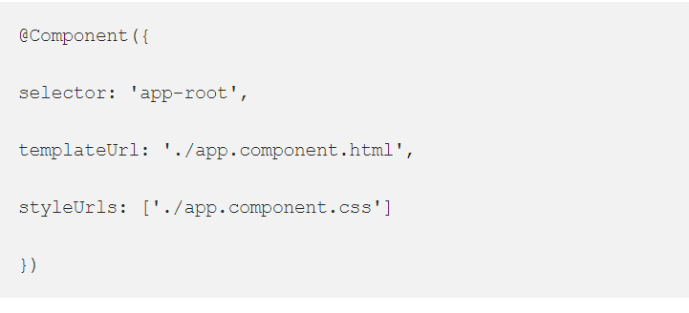
Metadata
Metadata in angular tells a javascript class, how it should be processed on screen. Usually we will pass meta data in the decorator’s.

Slide 3
Module
Component
Service
Metadata

Slide 4
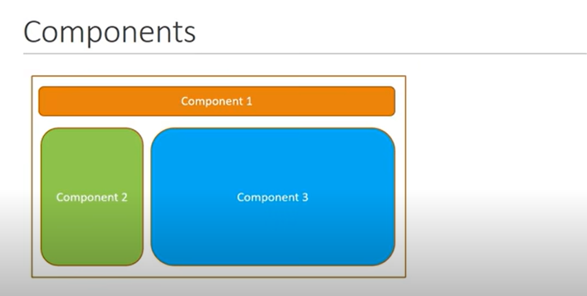

Slide 5
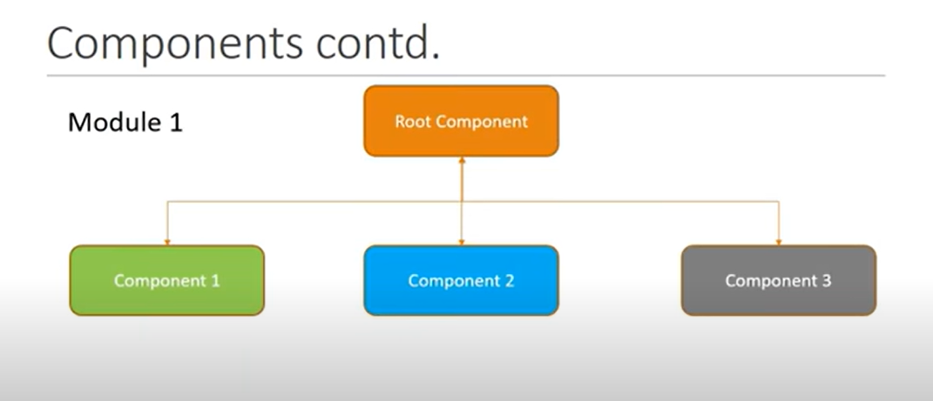

Slide 6
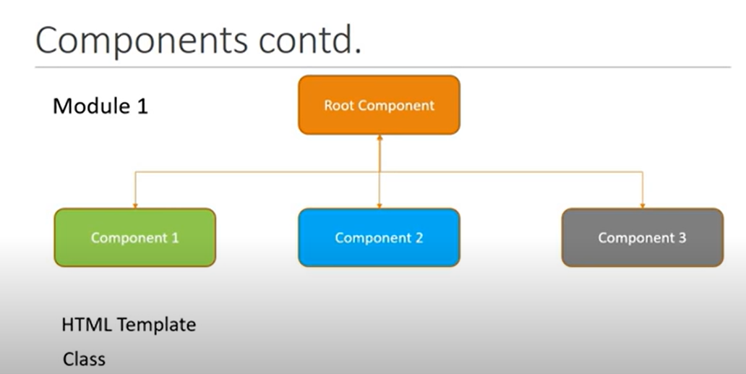

Slide 7
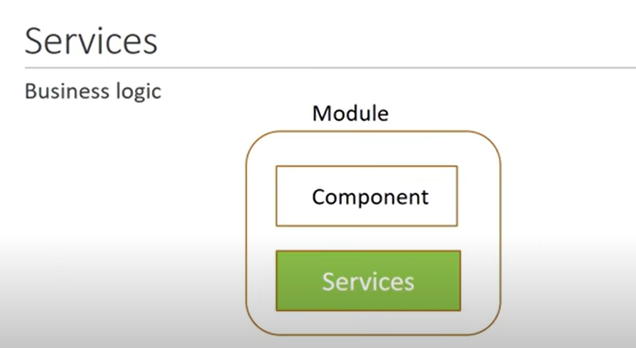

Slide 8
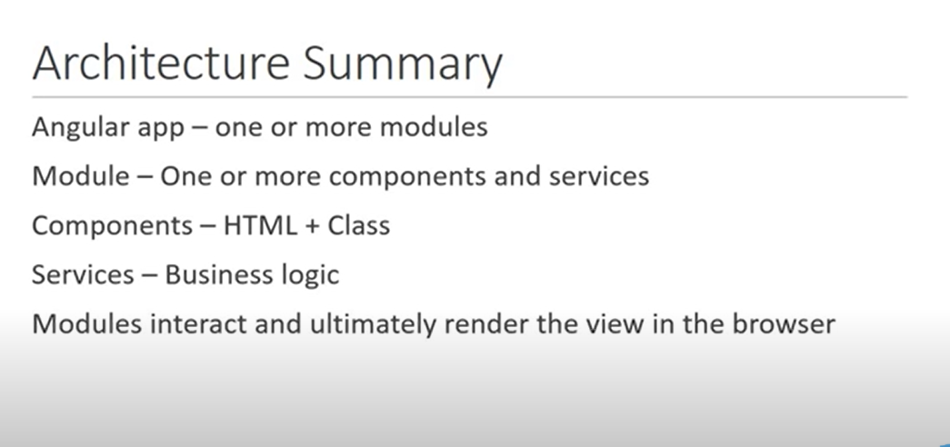

Slide 9
Command to start/run -> npm start / ng serve
ng new my-dream-app
Ng g c component-name
Package.json -> dependencies, dev dep, modules,scripts
Flow? Main.ts -> app.module-> app.component.ts -> app.component.html

Slide 10
@Component({
selector: '.app-test',
templateUrl: './test.component.html', -> html
styleUrls: ['./test.component.css'] -> css file
})
Interpolation -> binding data of class to template {{ }}
{{name }}->html
name = ‘user20’ in class

Slide 11
Property binding

Slide 12
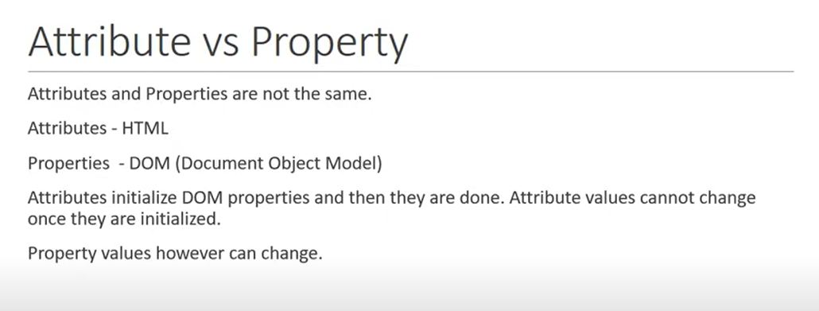

Slide 13
Selector -> custom html tag , that can be used to represent this component
1
selector: 'app-test',
<app-test></app-test>
2. selector: '.app-test',
<div class = 'app-test'></div>
3.
selector: '[app-test]',
<div app-test></div>

Slide 14
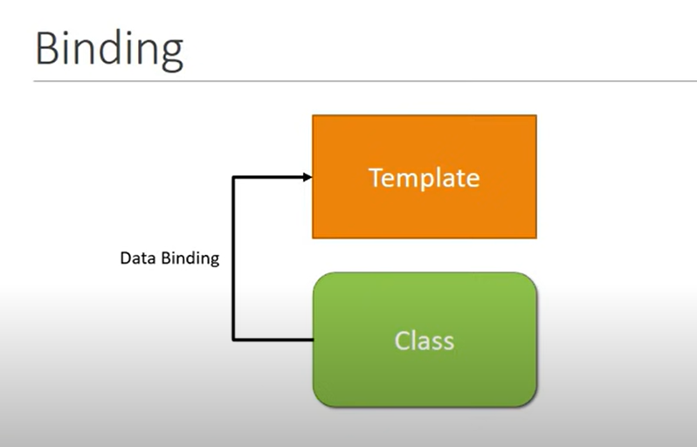

Slide 15
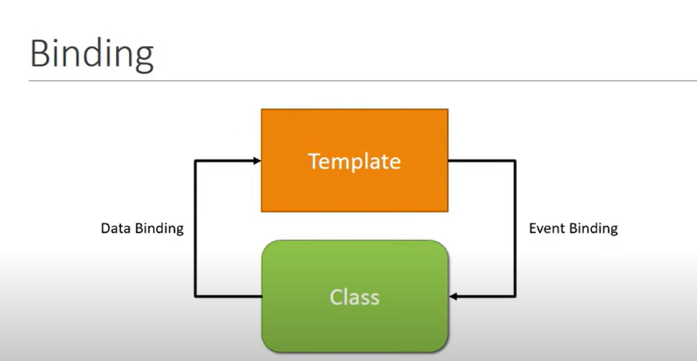

Slide 16
Event type

Slide 17
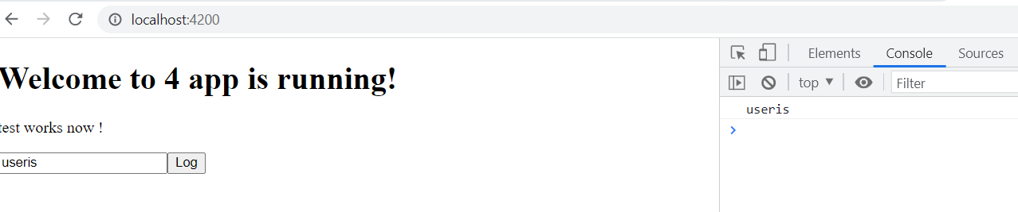
Template Reference Variables
Want some data to flow from template to class Eg: to do some validations
<input #myInput type ="text">
<button (click)="logMessage(myInput.value)" >Log</button>
logMessage(value){
console.log(value);
}

Slide 18
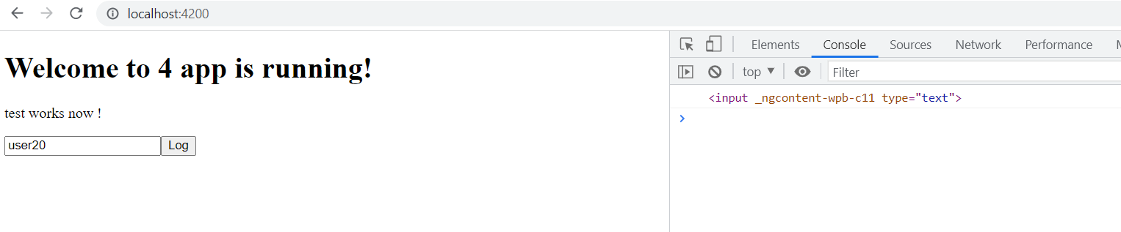
Input
<input #myInput type ="text">
<button (click)="logMessage(myInput)" >Log</button>
logMessage(value){
console.log(value);
}

Slide 19
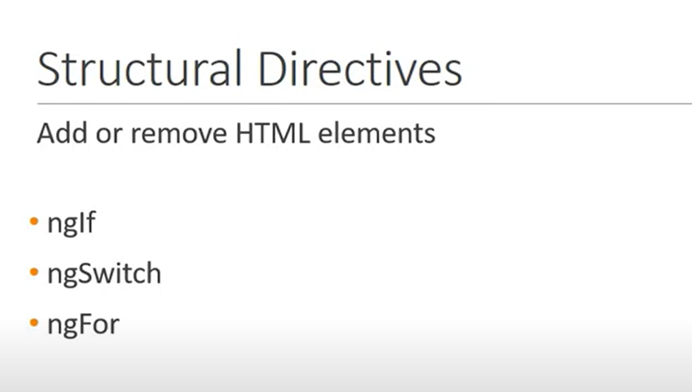

Slide 20
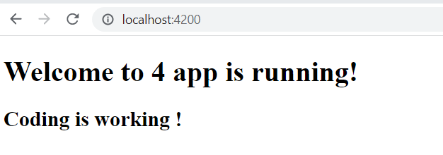
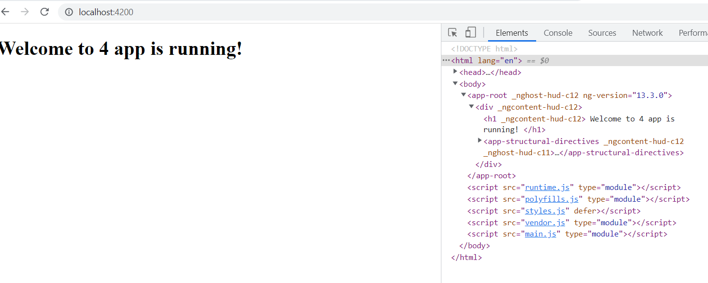
Created new project for understanding purpose 1.ng g c structural-directives2.add <app-structural-directives></app-structural-directives> in component.html
<h2 *ngIf = "true">
Coding is working !
</h2>
<h2 *ngIf = "false">
Coding is working !
</h2>
REMOVED FROM DOM ITSELF.IT’S DIFF FROM DISPLAY NONE

Slide 21
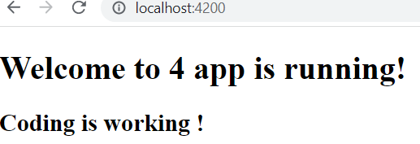
Assigning to a property
<h2 *ngIf = "displayName">
Coding is working !
</h2>
Ts:
displayName = true;
Toggle displayName as true & false, and check output

Slide 22
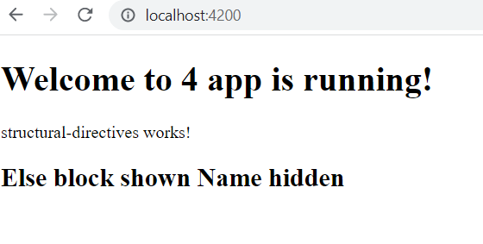
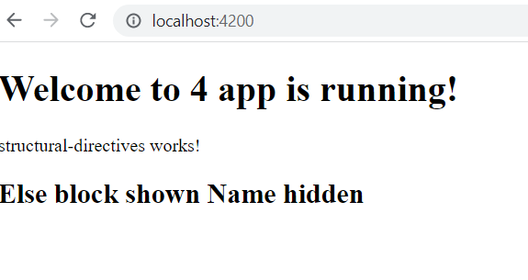
Else tag Another way
<h2 *ngIf="display; else elseBlock">
Coding is working !
</h2>
<ng-template #elseBlock>
<h2>
Else block shown Name hidden
</h2>
</ng-template>
TS file
display = false;
<div *ngIf="display; then thenBlock; else elseBlock"></div>
<ng-template #thenBlock>
<h2>Coding is working !</h2>
</ng-template>
<ng-template #elseBlock>
<h2> Else block shown Name hidden</h2>
</ng-template>
TS file
display = false;

Slide 23
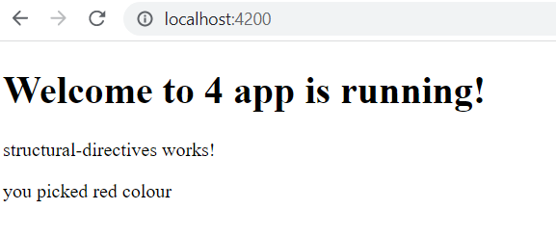
Ng switch - Compare with multiple conditions
<div [ngSwitch] = "color">
<div *ngSwitchCase="'red'"> you picked red colour</div>
<div *ngSwitchCase="'blue'"> you picked blue colour</div>
<div *ngSwitchCase="'green'"> you picked green colour</div>
<div *ngSwitchDefault>Pick again</div>
</div>
TS:
color= "red";

Slide 24
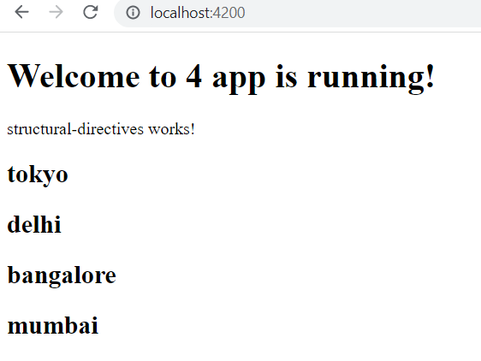
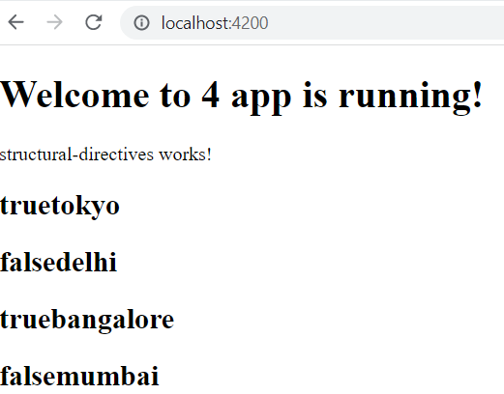
ngFor-> to retrieve elements one by one
Even try odd
public cities=["tokyo","delhi","bangalore","mumbai"];
HTML:
<div *ngFor = "let city of cities">
<h2>{{city}}</h2>
</div>
public cities=["tokyo","delhi","bangalore","mumbai"];
HTML:
<div *ngFor = "let city of cities; even as e">
<h2>{{e}}{{city}}</h2>
</div>

Slide 25
first,last index
public cities=["tokyo","delhi","bangalore","mumbai"];
HTML:
<!-- <div *ngFor = "let city of cities; first as f">
<h2>{{f}}{{city}}</h2>
</div> -->
public cities=["tokyo","delhi","bangalore","mumbai"];
HTML:
<!-- <div *ngFor = "let city of cities; index as i">
<h2>{{i}}{{city}}</h2>
</div> -->

Slide 26
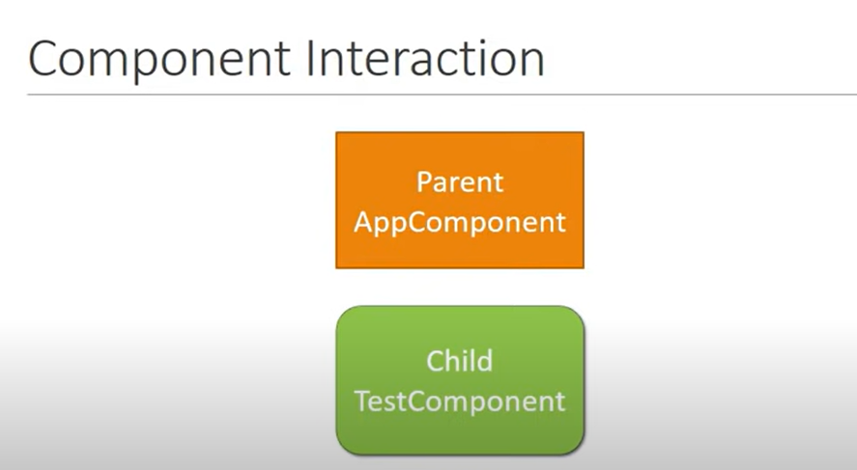

Slide 27
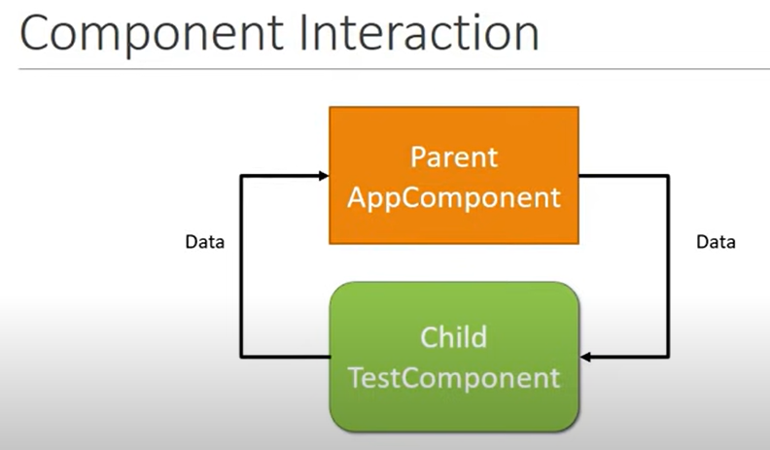

Slide 28
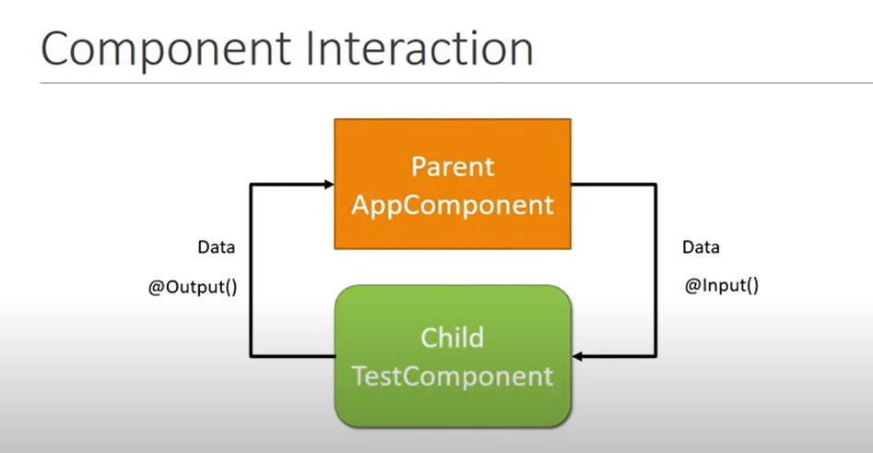

Slide 29
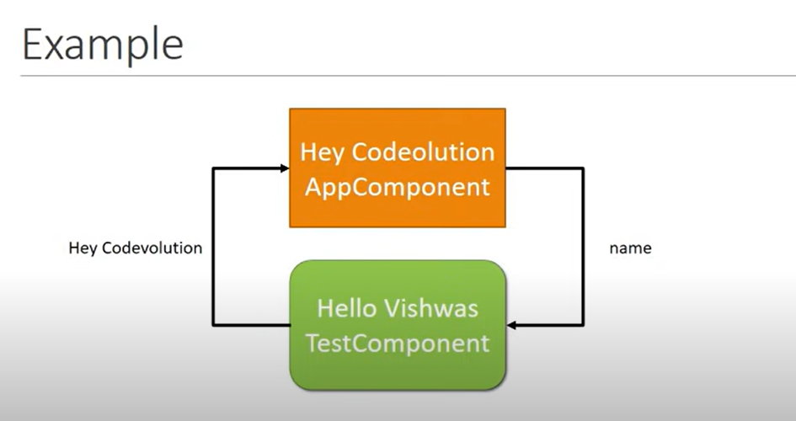

Slide 30
Parent to child
Parent ts:
public laptopName = "thinkPad";
Parent html:
<app-test [parentData] = "laptopName"></app-test>
Child html:
<h2>{{"hello" + newLaptopName}}</h2>
Child ts:
@Input('parentData')
public newLaptopName;

Slide 31
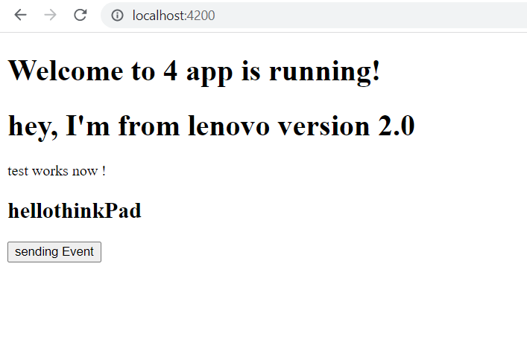
Child to parent
Child.ts
@Output()
public childEvent = new EventEmitter();
fireEvent(){
this.childEvent.emit("hey, I'm from lenovo version 2.0");
}
Child.html
<button (click)="fireEvent()">sending Event</button>
parent.ts
public messageIs = "";
parent.html
<app-test (childEvent) = "messageIs=$event" [parentData] = "laptopName"></app-test>

Slide 32
PIPES: transform data before displaying in view only
TS file
public name ="here is code"
public person = {
"firstName" :"hello",
"lastName" : "user24"
}
public date = new Date();
Html:
{{name}}
<h2>{{name | lowercase}}</h2>
<h2>{{name | uppercase}}</h2>
<h2>{{name | titlecase}}</h2>
<h2>{{name | slice:3}}</h2>
<h2>{{name | slice:3:8}}</h2>
<h2>{{person | json}}</h2>
<h2>{{0.25 | percent}}</h2>
<h2>{{0.25 | currency}}</h2>
<h2>{{0.25 | currency : 'GBP'}}</h2>
<h2>{{0.25 | currency : 'GBP':'code'}}</h2>
<h2>{{5.678 | number : '1.2-3'}}</h2>
<h2>{{5.678 | number : '3.4-5'}}</h2>
<h2>{{5.678 | number : '3.1-2'}}</h2>
<h2>{{15.3245 | number : '2.2-3'}}</h2>
<h2>{{15.3245 | number : '2.2-5'}}</h2>
<h2>{{15.3245 | number : '2.5-7'}}</h2>
{{date}}
<h2>{{date | date :'short'}}</h2>
<h2>{{date | date :'shortDate'}}</h2>
<h2>{{date | date :'shortTime'}}</h2>
<h2>{{date | date :'medium'}}</h2>

Slide 33
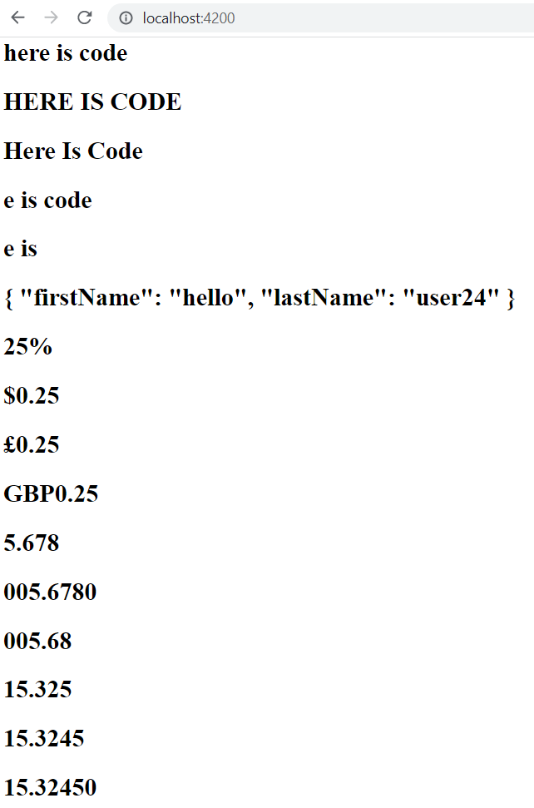
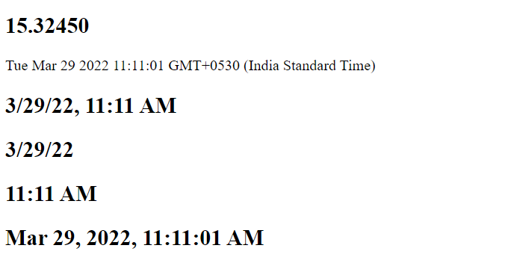

Slide 34
services

Slide 35
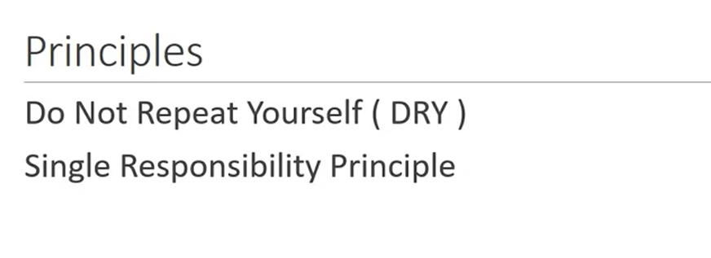

Slide 36
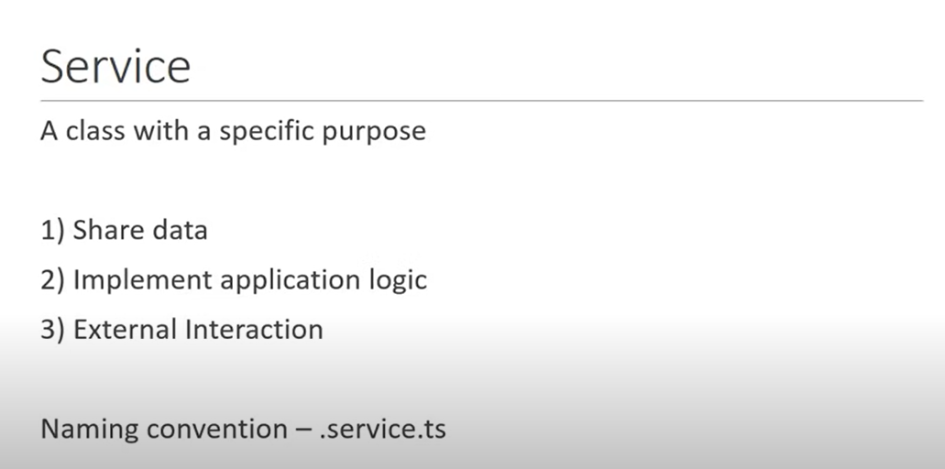

Slide 37
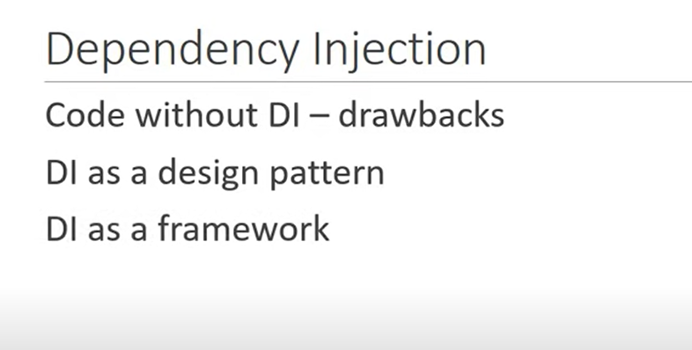

Slide 38
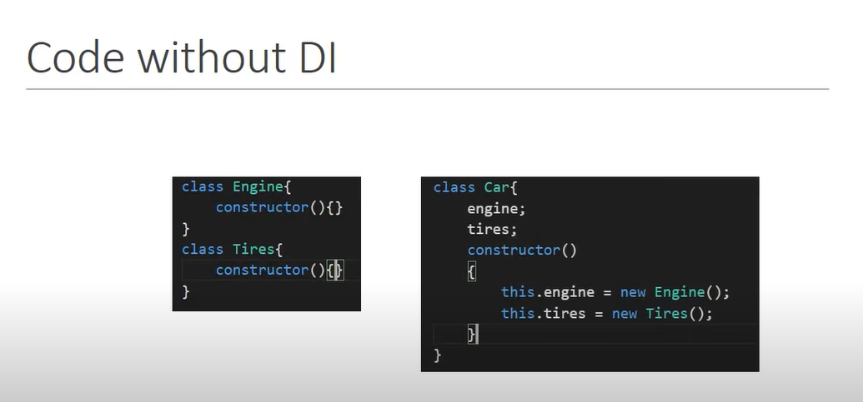

Slide 39
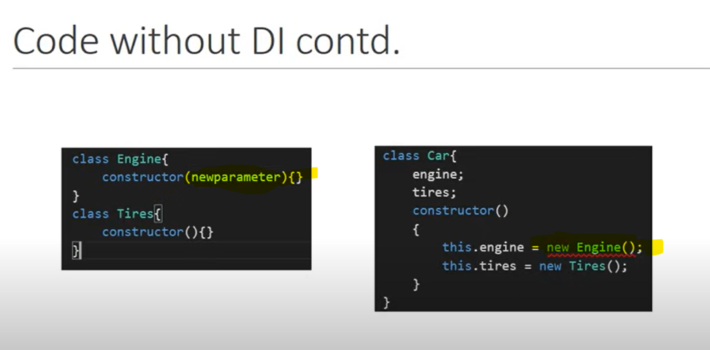

Slide 40
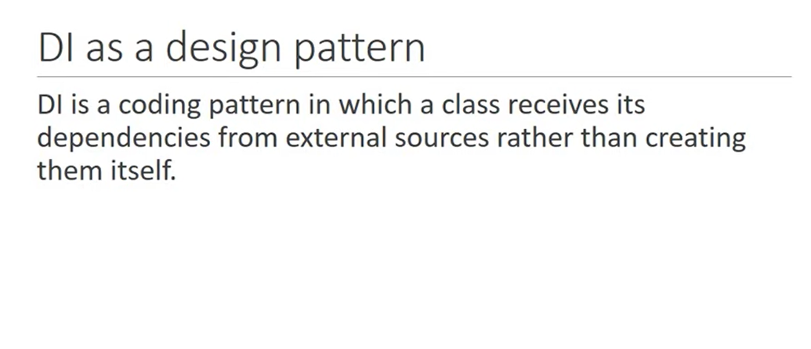

Slide 41
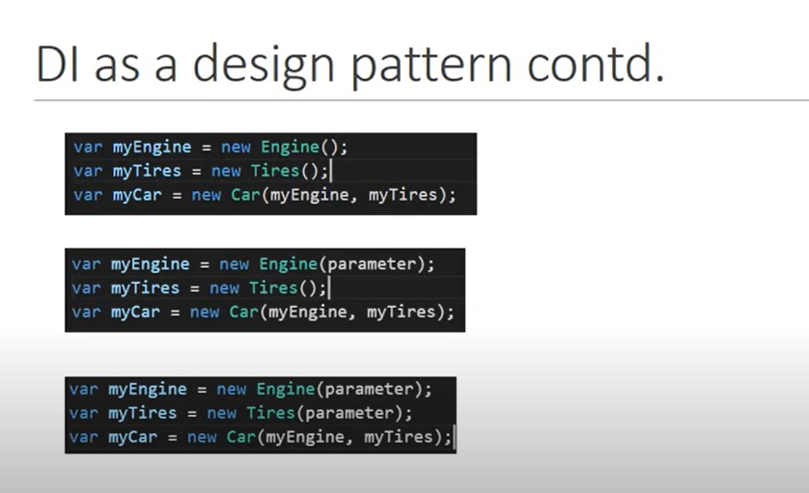

Slide 42
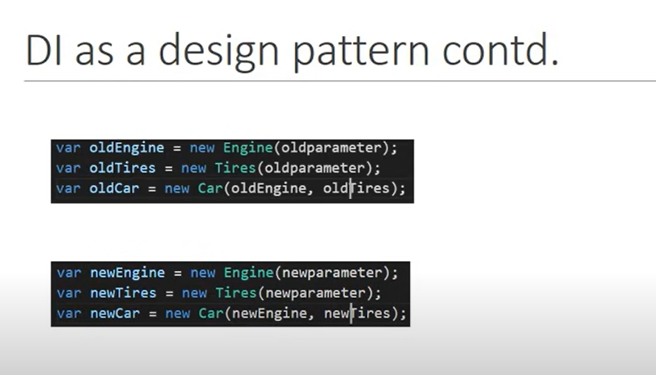

Slide 43
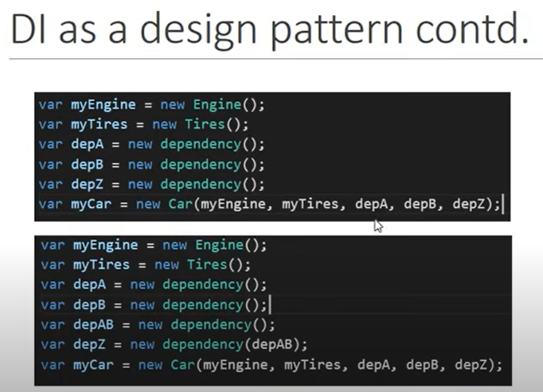
What if u have 10 dependencies?

Slide 44
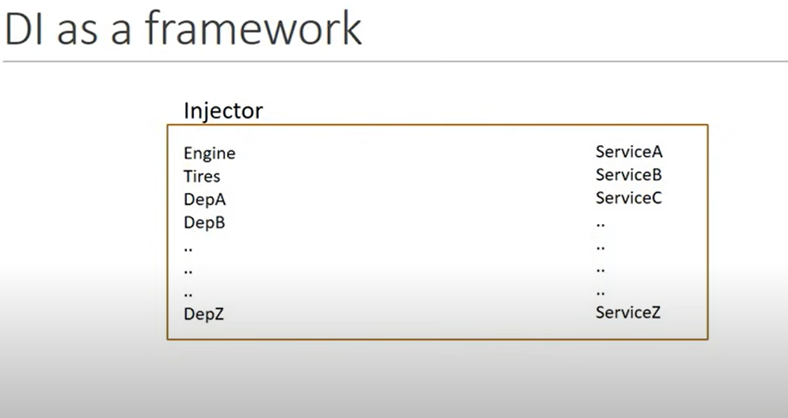

Slide 45
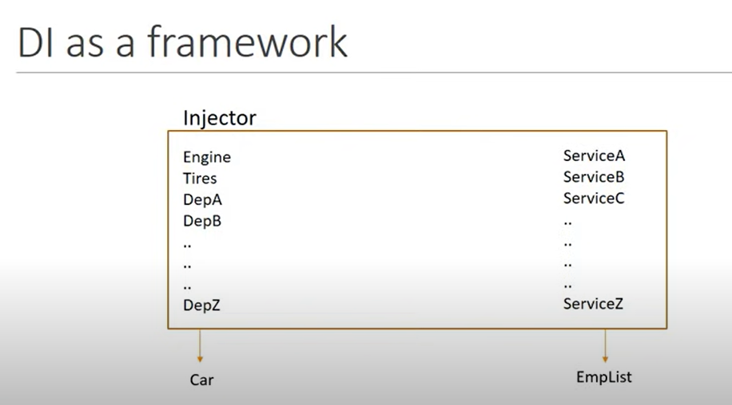

Slide 46
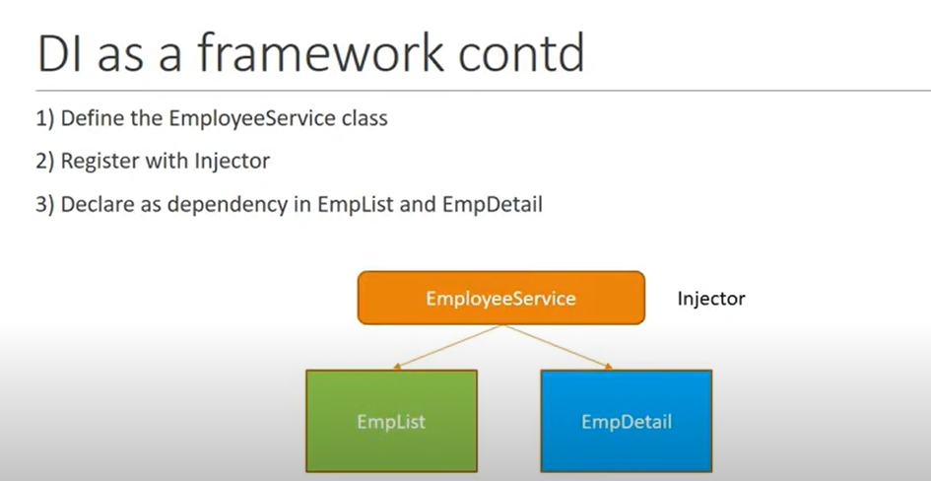

Slide 47
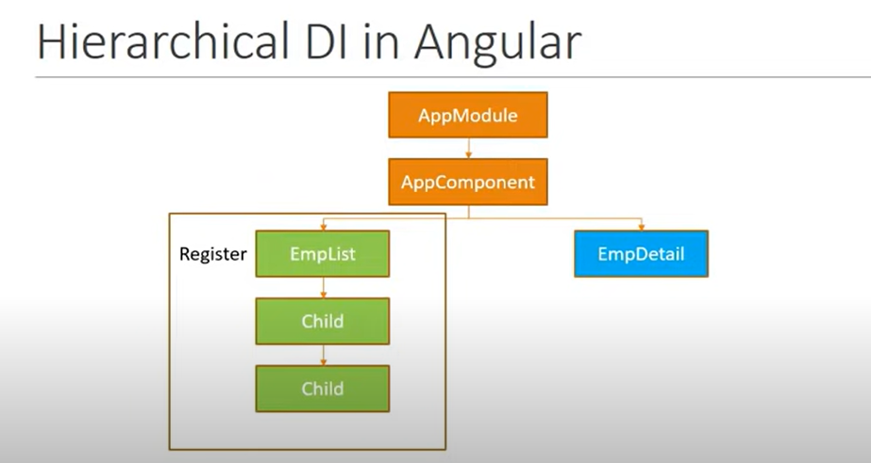

Slide 48
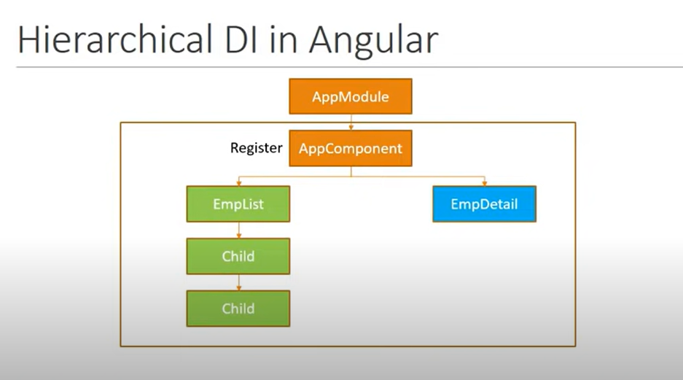

Slide 49
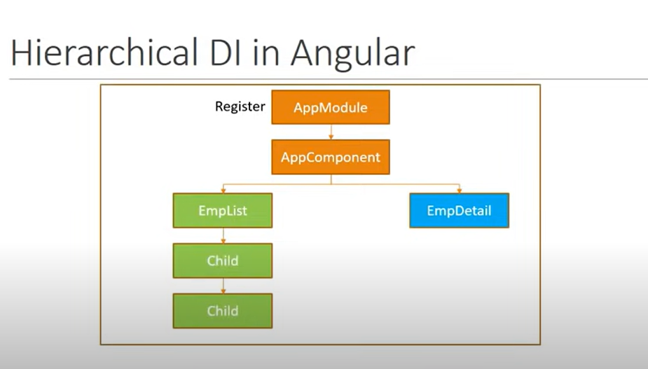

Slide 50
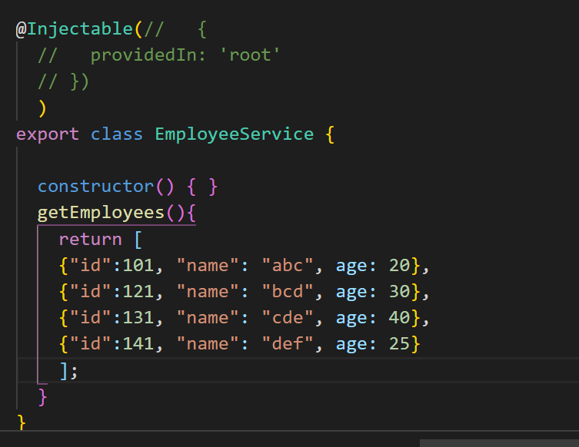
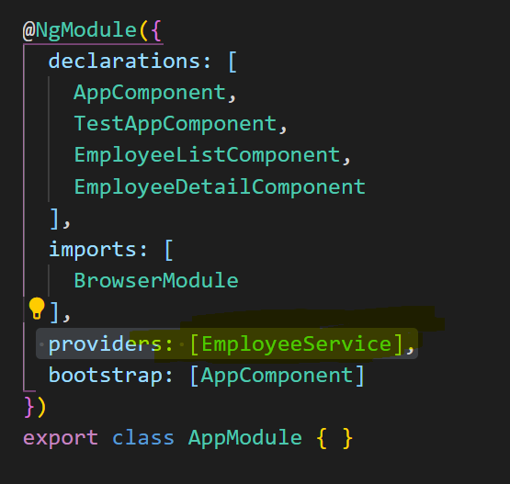
Create emp service
In appmodule.ts

Slide 51
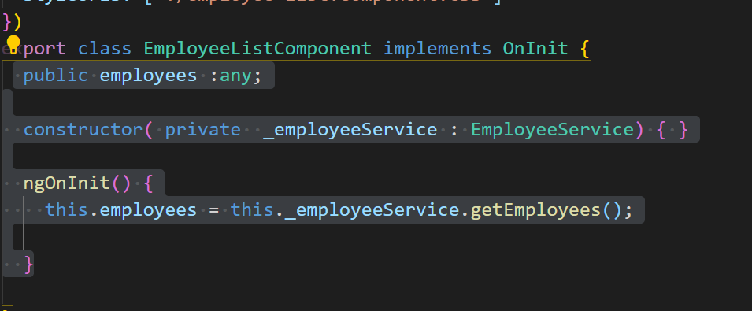
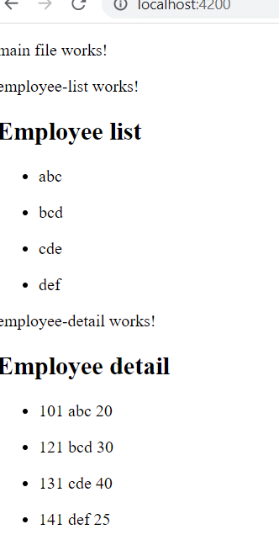
Same for employeelist and employeedetail

Slide 52
HTTP and Observables

Slide 53
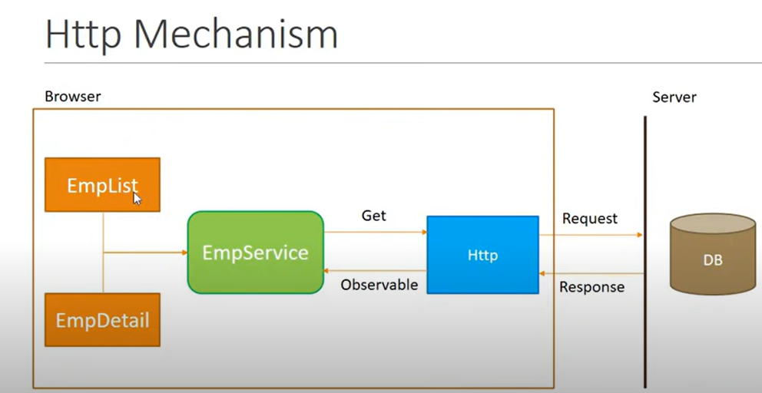

Slide 54
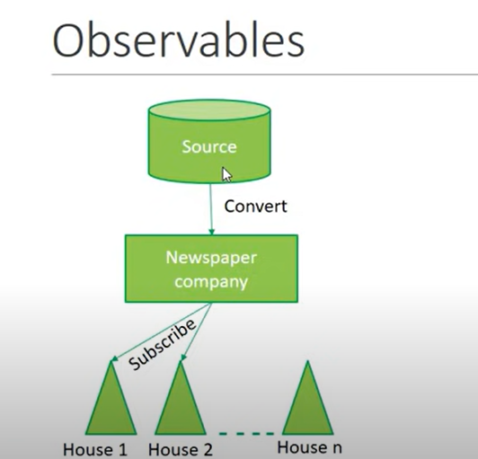

Slide 55
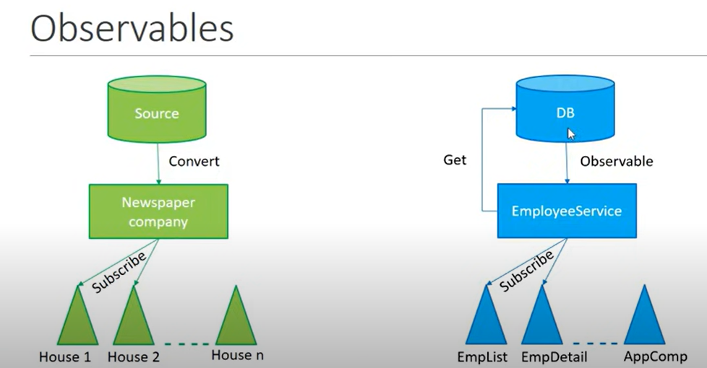

Slide 56
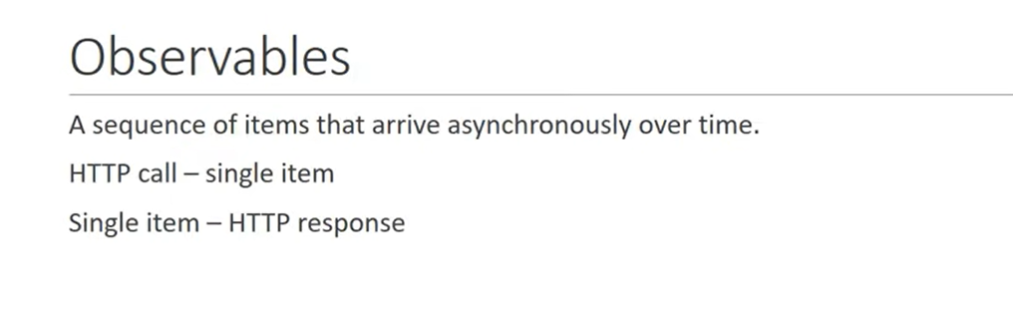

Slide 57


Slide 58


Fetch Data Using HTTP
Appmoduole.ts so, that http module is used for appmodule.
We are also registering http service with angular injector, we don’t have to explicitly declarate it in metadata
Employee service
We are ready to make getrequest to fetch data using HTTP

Slide 59



Slide 60


Slide 61


Now, 2nd step

Slide 62


emplist

Slide 64



Angular Tutorial - HTTP Error Handling
We need catch operator

Slide 65


Now, display it in emplist, empdetail
Both in emp list and emp detail

Slide 66


Slide 67


Slide 68


Slide 69
https://angular.io/guide/router-tutorial
Ng new routing-demo –routing
Ng g c department-list , ng g c employee-list
approutingmodule.ts
const routes: Routes = [
{path: 'departments' ,component: DepartmentListComponent},
{ path: 'employees' ,component: EmployeeListComponent}
];
export const routingComponents = [DepartmentListComponent,EmployeeListComponent]

Slide 70
4. With button
<nav>
<a routerLink ="/departments" routerLinkActive="active">Departments</a>
<a routerLink ="/employees" routerLinkActive="active">Employees</a>
</nav>
Css:
/* You can add global styles to this file, and also import other style files */
nav a.active{
color: aqua;
/* margin-left: 10px; */
}
nav a{
padding: 5px 10px;
}

Slide 71

Wildcard Route
Wrong url na, error shown
Ng g c page-not-found -it -is
In pagecomponent, <h3>pagenot found <h3>
In app-routing-module.ts -> {path : “**” , component:PageNotFoundComponent}
Add to routingcomponents as well
Note: pagenotfound path must be inlast always

Slide 72

Default route
{path: '' ,component: DepartmentListComponent},

Slide 73
Redirecting to default route: best way
{path: '' ,redirectTo: '/departments',pathMatch:'prefix'}
{path: '' ,redirectTo: '/departments',pathMatch:'full'}
Full works for us :)

Slide 74


Slide 75
In deplistcomponent.ts
departments = [
{"id": 1,"name":"Angular"},
{"id": 2,"name":"Node"},
{"id": 3,"name":"MongoDB"},
{"id": 4,"name":"Ruby"},
{"id": 5,"name":"Bootstrap"}
]
HTML:
<h3>
Department List
</h3>
<ul class="items">
<li *ngFor="let department of departments">
<span class = "badge">{{department.id}}</span>
{{department.name}}
</li>
</ul>
Deplist html
/* items class */
.items {
margin: 0 0 2em 0;
list-style-type: none;
padding-left: 0;
width: 10em;
}
.items li {
cursor: pointer;
position: relative;
left: 0;
background-color: #EEE;
margin: .5em;
padding: .3em;
height: 1.6em;
border-radius: 4px;
}
.items li:hover {
color: #607D8B;
background-color: #DDD;
left: .1em;
}
.items li.selected:hover {
background-color: #BBD8DC;
color: white;
}
.items .text {
position: relative;
top: -3px;
}
.items li {
cursor: pointer;
position: relative;
left: 0;
background-color: #EEE;
margin: .5em;
padding: .3em;
height: 1.6em;
border-radius: 4px;
}
.items .badge {
display: inline-block;
font-size: small;
color: white;
padding: 0.8em 0.7em 0 0.7em;
background-color: #607D8B;
line-height: 1em;
position: relative;
left: -1px;
top: -4px;
height: 1.8em;
margin-right: .8em;
border-radius: 4px 0 0 4px;
}
.items li.selected {
background-color: #CFD8DC;
color: white;
}

Slide 76


Slide 77
Now, wat i need is, when i click any item, url should change to department/id
Create new component ng g c department-detail -it -is
After created, let’s add a route to navigate to that component
app-routingmodule.ts
{ path: 'departments/:id', component: DummyDetailComponent },
Add in routingComponents also
HTML:
<h3>
Department List
</h3>
<ul class="items">
<li (click)=”onSelect(department)” *ngFor="let department of departments">
<span class = "badge">{{department.id}}</span>
{{department.name}}
</li>
</ul>

Slide 78

TS:
onSelect(department){
//this.router.navigate(['/departments', department.id]);
this.router.navigate([department.id], { relativeTo: this.route });
}
constructor(private route: Router)

Slide 79
Dept detail.ts
import { ActivatedRoute } from '@angular/router';
constructor(private route: ActivatedRoute) { }
//let id = parseInt(this.route.snapshot.paramMap.get('id'));
this.departmentId = id;
public departmentId;
<h3>You selected department with id = {{departmentId}}</h3>

Slide 80
Quick overview
https://medium.com/bycodegarage/building-blocks-of-angular-eafbb289b6d6

Slide 81
What is the difference between attributes and properties?
The difference is subtle.
Attributes are referring to additional information of an object.
Properties are describing the characteristics of an object.
Most people use these two words as synonyms.

Slide 82
Is it [()] or ([])? How will I remember?
The DOM is the side that is displayed (outside), and the component is internal (inside) — So, the squared brackets will be outside :)

Slide 83
https://cupofcode.medium.com/the-main-building-blocks-of-an-angular-application-explained-cup-of-angular-part-1-dce71c88d449

